Slide 1
De-escalation: A Crucial Tool in Libraries for Promoting Intellectual Freedom Moderators: Betsy Mahoney and Julia Nephew; Presenters: Janice Del Negro, Joyce McIntosh, and Steven Ward
Zoom’s Live Transcript is enabled.

Slide 2
The First Amendment, Challenges, and You
Prepared by Joyce McIntosh
Assistant Program Director, Freedom to Read Foundation
January 2023

Slide 3
Where are we at today?
2019: 377 challenges
2020: 156 challenges
(Pandemic Year)
2021: 729 challenges
1597 titles
Last 90 Days:
288 Challenges

Slide 4
Where are we at today?
Partisan advocacy groups targeting school and library boards
Disruptions/challenges at board public comment sessions
Challenges to diverse content fueled by social media
(LGBTQIA+, sex education materials)
Books addressing racism or the experiences of those who are (Black, Indigenous, or Persons of Color )
Board Recalls and Elections
Criminal Complaints targeting library staff, educators, and materials

Slide 5
Where are we at today?
Adverse State legislation
Bans or limits on discussing or teaching “divisive topics,” or “Critical Race Theory”
Bans or limits on discussing, teaching or providing information about LGBTQIA+ topics (“Don’t Say Gay”)
Eliminating longstanding legal defenses to obscenity prosecutions for librarians and educators
Filtering/regulation of research databases like EBSCO
Parental Rights / Private Right of Action / Parent Oversight Boards

Slide 6
Unite against book bans.org

Slide 7
A Limited Public Forum
As with any public forum the 1st Amendment protects people’s rights to use the forum without government interference related to the content of what is communicated there.
As a limited public forum, a public library may impose reasonable “time, place, and manner” restrictions (policies) on patron behavior.

Slide 8
Intellectual Freedom
Intellectual freedom is the right of unrestricted access to information and ideas, protected by the First Amendment.
Protected Speech
The First Amendment applies to government entities, not private entities. A store owner can make his or her own rules. The library trustees have to function within government rules and regulations.
We are legally bound to follow our policies and they cannot be created in a way that limits a person’s First Amendment protection. And students, in a public school setting, are also protected.

Slide 9
Censorship
Censorhip is the efforts to ban, prohibit, remove, label or restrict library materials, based on the belief that the materials will corrupt children, offend the unwary reader, or undermine moral values.

Slide 10
But this content is:
Obscene
Harmful to minors
Pornographic

Slide 11
Obscenity
Miller v. California, 413 U.S. 15 (1973).
The material must meet all three parts of the legal test established by the Supreme Court in the Miller v. California decision to be found obscene by a court of law
Whether the work depicts or describes, in a patently offensive way, sexual conduct specifically defined by the applicable state law, and
Whether the average person, applying “contemporary community standards” would find the work, as a whole, appeals to the “prurient interest,” and
Whether the work, taken as a whole, lacks serious literary, artistic, political or scientific value.

Slide 12
Harmful to Minors
Ginsberg v. New York, 390 U.S. 629 (1968).
“Harmful to minors” or “obscene as to minors” materials: the test parallels the obscenity test set forth in Miller, but the considerations are in the context of offensiveness and serious value for minors.

Slide 13
With challenges to materials always remember:
We’re ensuring access, not defending content.
As a limited public forum we can have time, place, and manner rules which must follow government laws.
Time, place and manner restrictions are included in our policies and patrons, parents, librarians, teachers, administrators, and library staff must all follow the policies to protect everyone’s Constitutional rights.

Slide 14
Feel free to reach out with any questions. jmcintosh@ala.org

Slide 15
De-escalation: A Crucial Tool in Libraries for Promoting Intellectual Freedom
Steven Ward Library Director

Slide 16
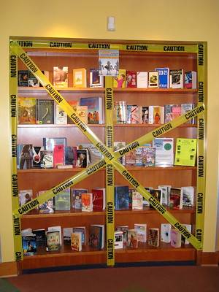
Intellectual Freedom Should be Celebrated!

Slide 17
De-escalation via Library Policy
Patron Conduct Policy
Collection Development Policy
Selection Criteria
ALA Bill of Rights
ALA Freedom to Read
ALA Freedom to View
Request for Reconsideration

Slide 18
Request for Reconsideration Section of Policy
Suggested Best Practices:
Clearly define process from beginning to end
Consider steps before allowing a formal complaint
Who will have an initial conversation with the patron?
What might they do to satisfy the patron’s concern?
When to involve management?
Request for Reconsideration Form

Slide 19
Request for Reconsideration Form
Ask for specifics:
Who do they represent?
What do they object to?
Did they read, listen to, view entire item?
What do they believe is the theme?
What is their recommendation?
Consider requests beyond your community
Provide Supplemental Materials
Collection Development Policy
ALA Bill of Rights, Freedom to Read & View
Intellectual Freedom Principles for Academic Libraries

Slide 20
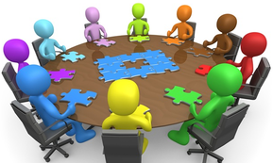
Process After a Formal Written Complaint
Notify Managers, Board and/or Admin Officials
Form a committee, do not act alone
Have a timeline and stick to it
Provide written notification of decision
If this does not satisfy the patron:
Allow the patron to petition the decision
Add to agenda and invite patron to a meeting, if possible
Provide written notification of final decision
Decision is final for X years

Slide 21
Preparation is the Key to De-escalation!
Help educate your Library Staff, Colleagues, Library Board and/or Admin Officials
Encourage professional development opportunities
Have one-on-one conversations, use staff meetings to role-play scenarios, incorporate into on-boarding and staff training

Slide 22
De-Escalating Challenges
Conversation and Conflict

Slide 23
Individual Challenges
Challenges brought to you from an actual patron vs. organized political challenges
This Photo by Unknown Author is licensed under CC BY-ND

Slide 24
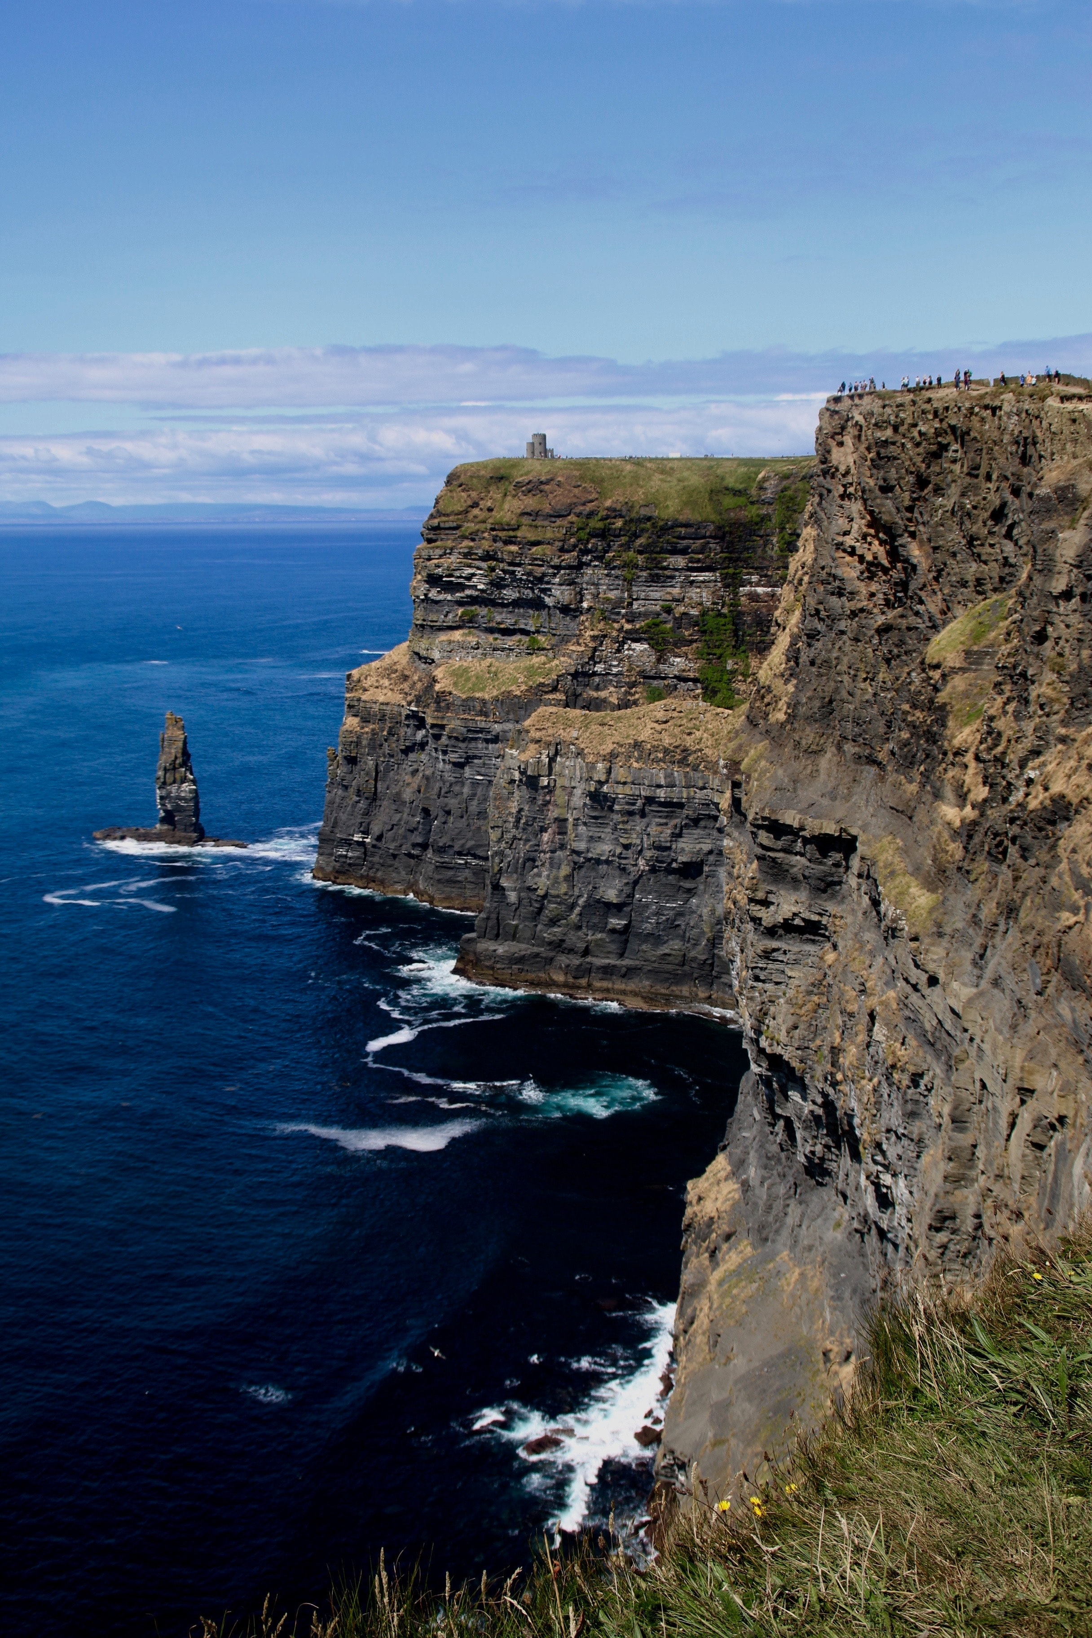
Policy is Good.
But never follow a rule off a cliff. Many times people just want to be heard.

Slide 25
Stay calm. (This is easier said than done.)
This Photo by Unknown Author is licensed under CC BY-NC-ND

Slide 26
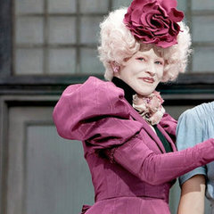
Breathe.
Maintain your professional face.
This Photo by Unknown Author is licensed under CC BY-ND

Slide 27
De-escalation info:
Mental health agencies, doctor’s offices, and of course, ALA.
This Photo by Unknown Author is licensed under CC BY-SA

Slide 28
De-Escalation Tips:
LOWLINE:
Listen to what the issue is and the person's concerns.
Offer reflective comments to show that you have heard what their concerns are.
Wait until the person has released their frustration and explained how they are feeling.
Look and maintain appropriate eye contact to connect with the person.
Incline your head slightly, to show you are listening and give you a non-threating posture.
Nod to confirm that you are listening and have understood.
Express empathy to show you have understood.
https://www.health.nsw.gov.au/mentalhealth/psychosocial/strategies/Pages/managing-anger.asp

Slide 29
Listen
Non-directive feedback:
“Can you tell me more about that?”
“Please let me understand exactly what troubles you.”

Slide 30
Active listening:
Non-verbal signals such as facial expression and body language.
Paraverbal communication including tone of voice, inflection and volume.

Slide 31
Offer
Let people vent

Slide 32
Wait
Don’t rush in

Slide 33
Look
Remain as neutral as possible

Slide 34
Incline
Respond with your own non-verbal cues

Slide 35
Nod
A nod when appropriate can show maintained interest and willingness to listen without interrupting.

Slide 36
Express
Use active listening skills to express empathy and a desire to understand

Slide 37
We wish it was that easy.
This Photo by Unknown Author is licensed under CC BY

Slide 38
Control is an Illusion
We cannot control what happens in our spaces, we can only control how we respond to it.
And that takes practice.

Slide 39
Practice
Responding to confrontation
What you will say
How you will say it

Slide 40
What story are we telling?
Response to challenges must be consistent
Everyone must be telling the same story

Slide 41
Organized political challenges…
…are different animals, but require the same consistent responses

Slide 42
Transparent POLICY
Established library policy and the legal rights of libraries combine to assist in handling challenges

